Slide 1
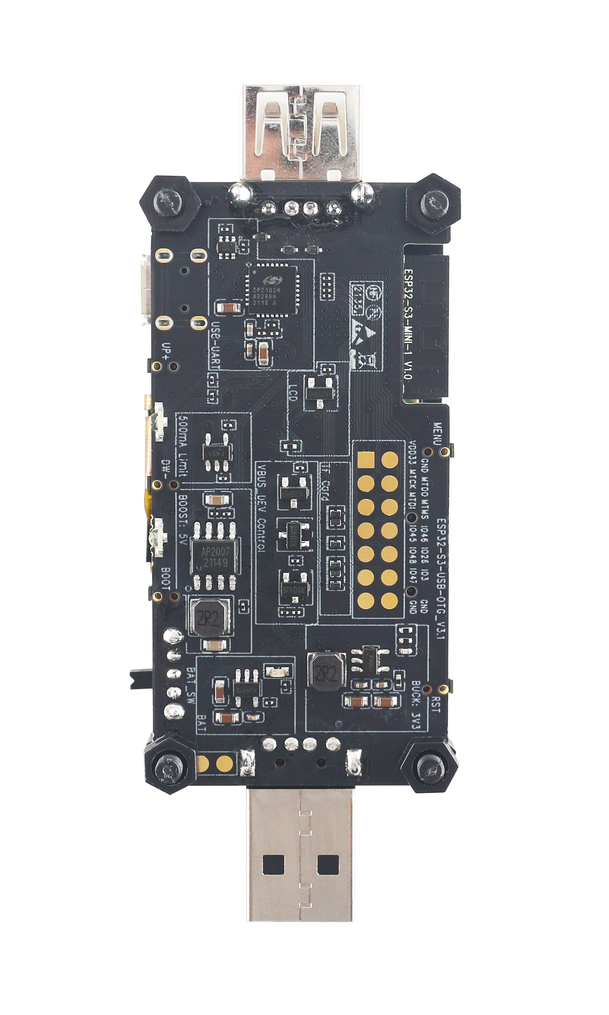
USB-to-UART Bridge
Yellow LED
Green LED
Free Pins
Charging LED
Charging Circuit
Battery Solder Joints

Slide 2
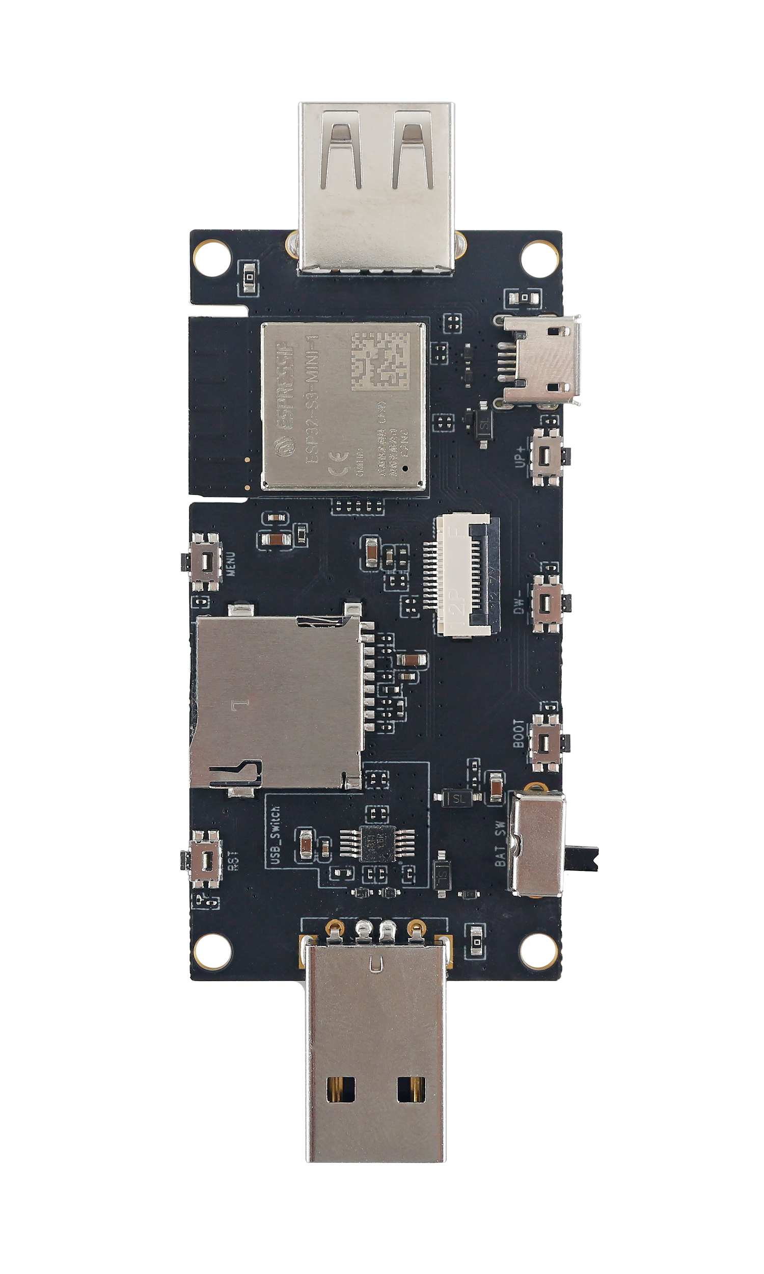
USB_HOST Interface
USB-to-UART Interface
ESP-S3-MINI-1 Module
UP+ Button
MENU Button
LCD FPC Connector
DW- Button
Micro SD Card Slot
Boot Button
USB Switch IC
Reset Button
Power Switch
USB_DEV Interface

Slide 3
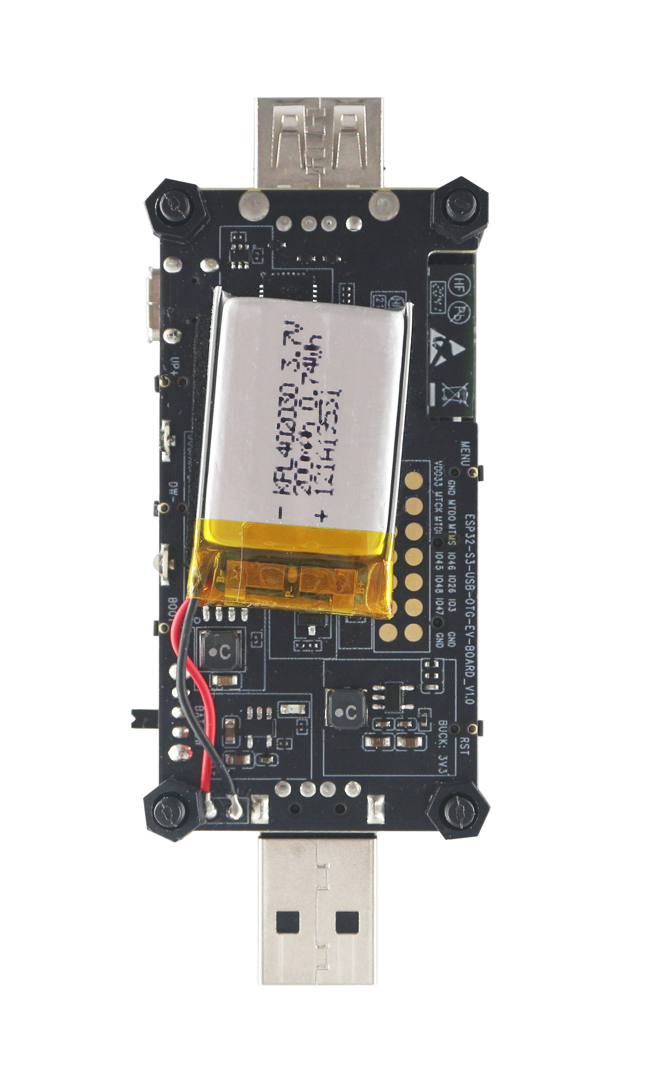
+
-

Slide 4
